Slide 1
Entity Linking & Entity Disambiguation Survey
01

Slide 2



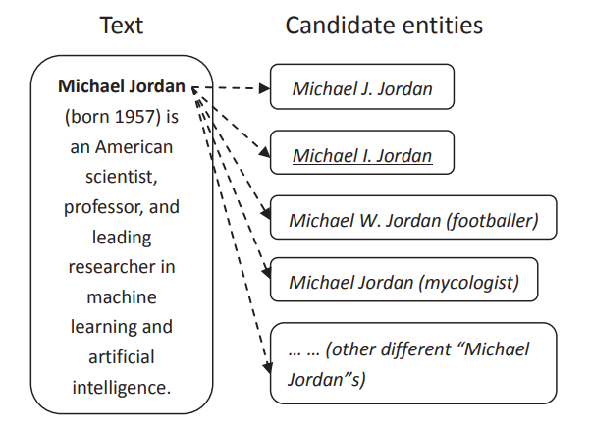
Entity Linking
1.1
Why Entity Linking (EL) – the process of matching a mention.
Entity linking: Identifying an mention in the (unstructured) text and establishing a link to an entity in a (structured) knowledge graph.
EL Application: QA and information retrieval…
Three parts: mention detection, entity disambiguation and linking entity.
Apple released the latest product iPhone13.
Entity
However, the biggest difficulty in EL occurs around entity disambiguation because of the ambiguity of entities. The result of Mention Detection are difficult to attach directly to the knowledge graph. And hence, our project will mainly focus on ED.
Different Mentions
Notes:
Entity linking is an essential component of many information extraction and natural language understanding pipelines, it resolves the lexical ambiguity of entity mentions and determines their meanings in context.
For example, given a sentence "Apple released the latest product iPhone13", the entity linking system needs to map the "Apple" in the text to a technical company instead of a fruit.
EL technique can be widely used. QA and information retrieval are two typical fields.
EL consists of mention detection, entity disambiguation and linking entity. However, the biggest difficulty in EL occurs around entity disambiguation because of the ambiguity of entities. MD’s results are difficult to attach directly to the knowledge graph. And hence, our project will mainly focus on ED.

Slide 3
Entity Disambiguation Related Work
1.2
Entity link disambiguation:
Map a mention in context to corresponding entity in the database.
A BERT based model : introduce a global coherence mechanism.
Document level’s information will be beneficial. And this model provide a novel idea to add global information for ED.
Jointly perform MD and ED
Neural end-to-end EL system that jointly discovers and links entities in a text document.
Structured text based entity disambiguation:
Calculate and rank the similarity score of detected mentions and corresponding candidates.
Notes:
In order to better understand the task and how others dealing with the problem, we had reviewed the recent works. And we pick three of them to introduce.
The first one is …: Since entities are usually stored in a database and represented as a structured text record. An idea to solve the ED task is to directly …., which refers to our first model.
The second method is to …. The second model proposes a …, which is the second model we are going to introduce.
The last one is … ,This is our third model

Slide 4
Dataset & Task Introduction
02
Notes:
Next we are going to make introduction of our dataset and intuitively describe our task

Slide 5
Extracted Data’s Structure(Python Class)
1.3
Document
Mention
Candidate
Attribute
Id
Words
Mentions
Attribute
Text
Start
End
Title
Candidates
Attribute
Title
Prior prob
Notes:
We construct our dataset via these three python classes.
Document take Document id, tokenized results of raw text as words, and all tagged mentions as it third attributes.
And the elements of the Document’s mentions is another class. Besides the mention itself, this class also store the context of the mention, the position of the mention within the text, and the generated candidates of the mention.
And the last class is candidate, which is the sub elements of mentions attributes candidates, contains the candidate content and its prior probability.

Slide 6
Task Description
1.3
Calculate Score
CANDIDATES
Lebron James
Mike James
James Bond
SCORE
0.7
0.54
0.3
James is one of the greatest basketball player in the world
Predicted Entity
Notes:
And the task in detail, is try to make prediction of a entity that the given mention belongs to by using ranking mechanism.

Slide 7
Model One
03
USE-pretrained-model based encoder

Slide 8
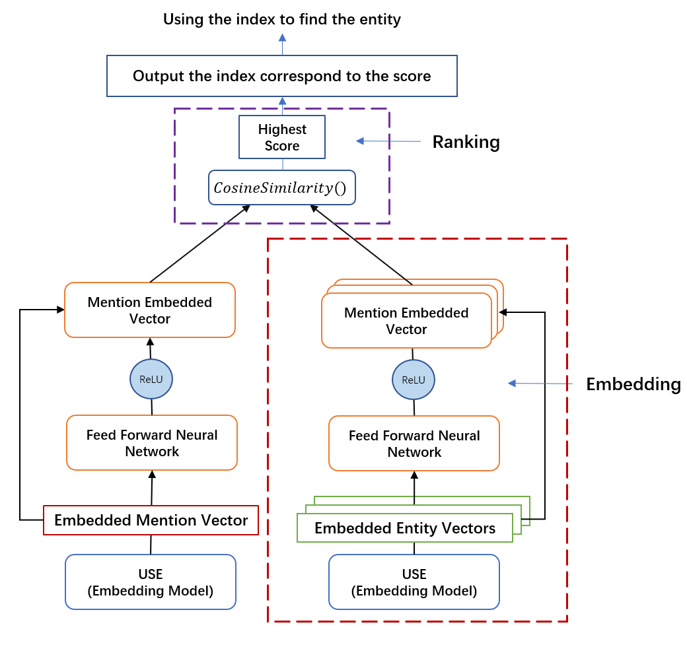
Model Details
4.1
Thought: Fine-tune the pretrained model
Model Input: Mention / Entity
Model Output: Entity of highest score
Training:
Loss: L1Loss(reduction=‘sum’)
Candidates vectors
Mention vector
Optimize Method: SGD
Property:
Pretrained Model
Skip Connection
Shared Parameters
Notes:
Here is the structure of our model. We propose an addition feed forward neural network upon the origin USE model. The input of the encoder is either entity or mention. And the encoder part of the model will output a fix-length vector. And once we construct vectors representation for both mention and entities, we are then able to calculate the cosine similarity score for mention and its candidates and detect the one with the highest score as the output.
The idea of improving the pre-trained model is so call fine tuning. And the Loss function we used is L1Loss with reduction equals to sum. And our training target is to maximize the similarity of mentions’ vector representation and target entity vector representation
But one limitation of this model is it cannot make prediction for those mentions whose candidate doesn’t include its target entity.

Slide 9
Model 2
04
End-to-End Neural Entity Linking

Slide 10
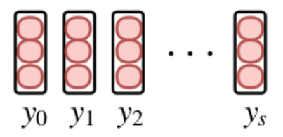




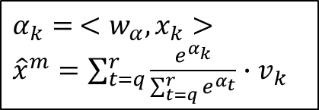






5.1
Model details
Score $Ψ\left(e_{j},m\right)$
FFNN
$α_{k}= <w_{α},x_{k}>$
${\hat{x}}^{m}=\sum_{t=q}^{r}{\frac{e^{α_{k}}}{\sum_{t=q}^{r}{e^{α_{t}}}}∙v_{k}}$
$$<x^{m},y_{j}>$$
$$log p(e_{j}|m)$$
Dot Product
FFNN
$$[x_{s}, x_{t}, {\hat{x}}^{m}]$$
$$x^{m}$$
$$y_{j}$$
Represent
$$x_{k}$$
Mention
$Bi$-$LSTM$
1. Word (Word2Vec)
2. Char (Bi-LSTM)
$$v_{k}$$
3. Concatenate

Slide 11

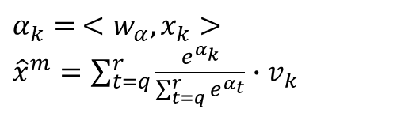
Advantage
5.2
Bi-LSTM model to detect the mention
The span of the words in a mention is not large
Get the Context Information
Mention representation
$$[x_{s}, x_{t}, {\hat{x}}^{m}]$$
$α_{k}= <w_{α},x_{k}>$
${\hat{x}}^{m}=\sum_{t=q}^{r}{\frac{e^{α_{k}}}{\sum_{t=q}^{r}{e^{α_{t}}}}∙v_{k}}$
Use attention model to get interval information
Focus on the boundary !

Slide 12
Model 3
05
Global Entity Disambiguation with BERT

Slide 13
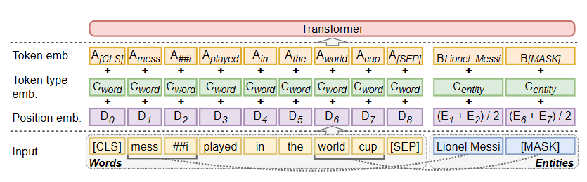
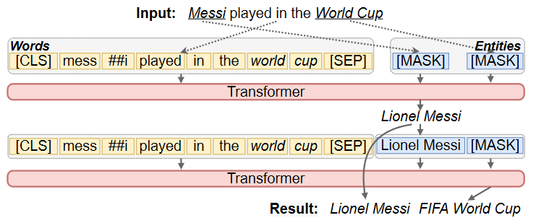
Model Details
6.1
Model Input: Raw text + Entities
Model Output: Entity of highest score
Global Coherence.
Masked Prediction
Sequentially Inference
Novelty:
Global coherence
Masked entities prediction (Training task)
Randomly replace words with MASK
Maximizing the log likelihood of entity predictions (Training target)
Notes:
The third model is a BERT based model. The novelty of this model is it include the global coherence the assist the ED.
In details, the model start with two masked entity. And require model to predict them. And then adding the predicted entity to a global entity list. And for each iteration. The model will calculate the score between mention and global entities and using the top-k entity as the input of the task. That is to say, the model are executed sequentially.

Slide 14
Model Details
6.1
First Round:
All entities in the input is “[MASK]”.
Model then predict the masked entity and add it to global entity list
Second Round:
Calculate the similarity score between mention and every elements in global entity list
Pick the top-k entities
Concatenate the entities with text as the input
Notes:
The third model is a BERT based model. The novelty of this model is it include the global coherence the assist the ED.
In details, the model start with two masked entity. And require model to predict them. And then adding the predicted entity to a global entity list. And for each iteration. The model will calculate the score between mention and global entities and using the top-k entity as the input of the task. That is to say, the model are executed sequentially.

Slide 15
Experiment
06

Slide 16
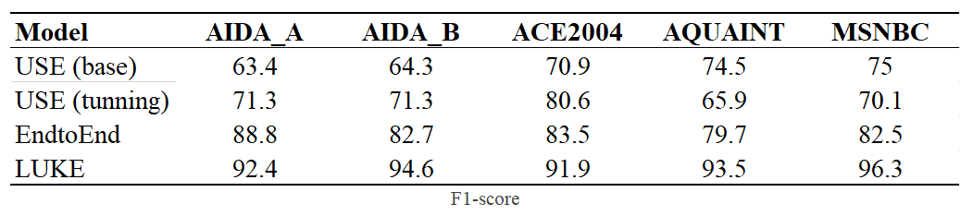
Experiment
7.1

